Slide 1
FORAGING
Vishal Kannan Parthiban Saravanakumar

Slide 2
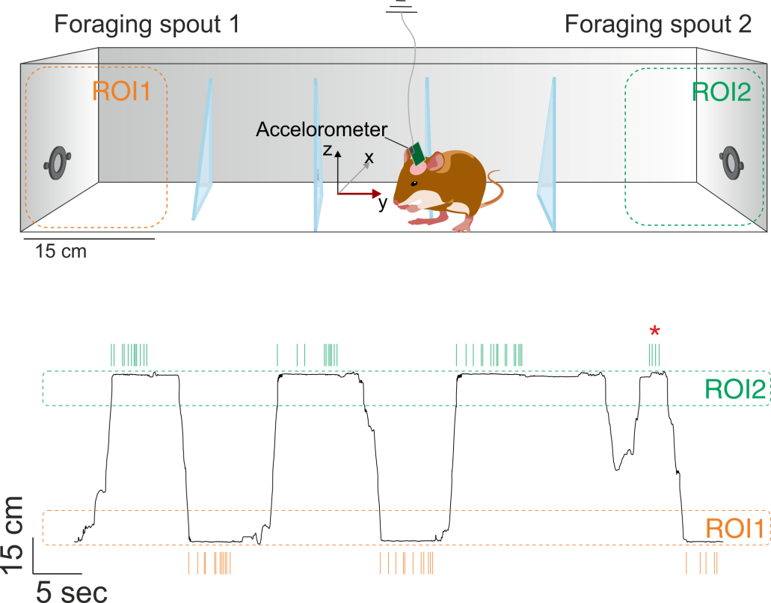
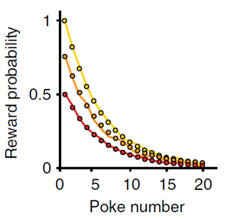
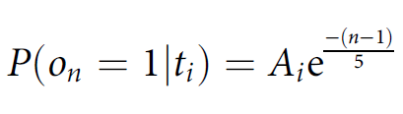
Behaviour Paradigm
Each food restricted animal was trained for 25 days (sessions) continuously in the foraging paradigm without any breaks
Lottem et al., 2018

Slide 3
The trials, rewards and pokes
Last poke
Unrewarded
Pokes
Trials with starting reward probability = 1
Trials with starting reward probability = 0.75
Rewarded
Trials
Trials with starting reward probability = 0.5
First poke
Unrewarded pokes
Unrewarded
Note: Coloured pokes are rewarded
Lottem et al., 2018

Slide 4
Events, consequence, and decisions
Last poke
Unrewarded
What make the last poke the last?
Exploitation to exploration shift
(last rewarded poke to last poke)
Pokes
Overall cortical dynamics – frontal activity
Trials
Rewarded
Cortical layer dynamics
First poke
Unrewarded

Slide 5
The trials, rewards and pokes
Last poke
Unrewarded
Pokes
Last rewarded poke
Trials with starting reward probability = 1
Trials with starting reward probability = 0.75
Rewarded
Trials
Trials with starting reward probability = 0.5
First poke
Unrewarded pokes
Unrewarded
Note: Coloured pokes are rewarded
Lottem et al., 2018

Slide 6

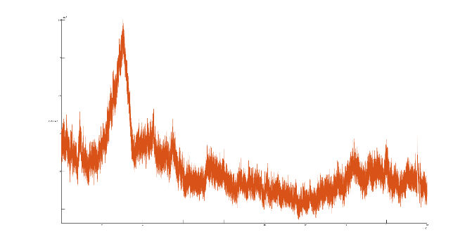
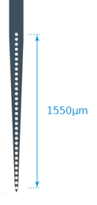
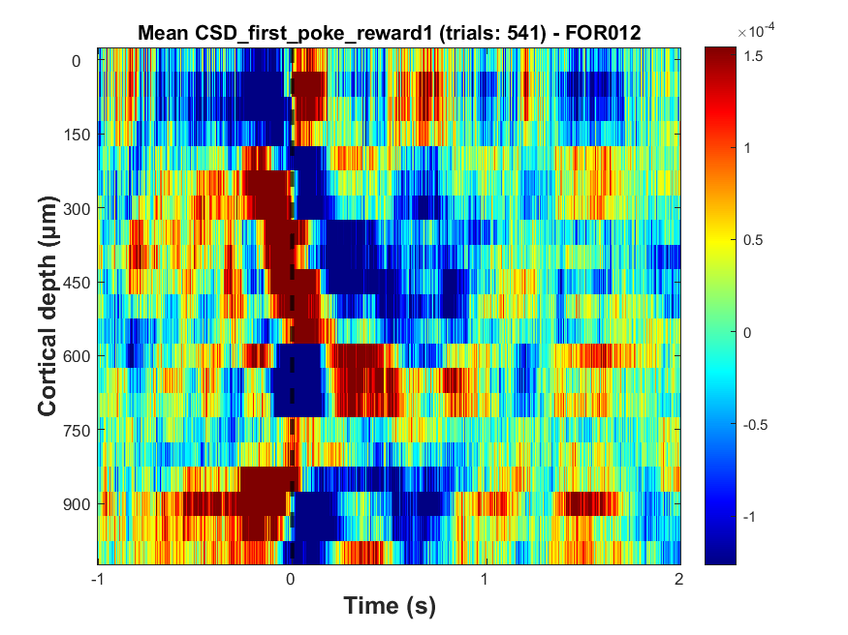
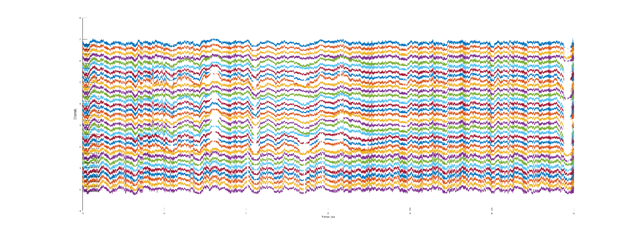
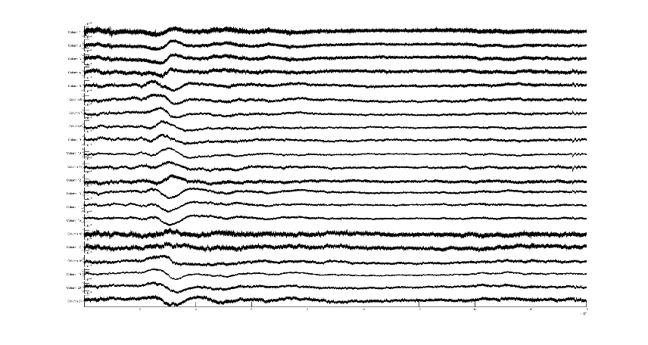
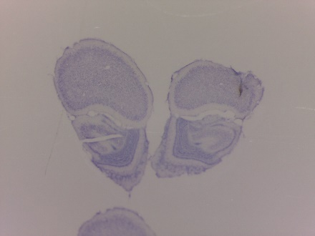
PROCESSING
Second spatial derivative
Layers
I/II/III
Bregma: 4.65mm; ML: 1mm
IV
Va
Vb
VI
Local field potentials
(LFPs)
sink
source
AVREC
Nissl Staining
Current Source Density
(CSD)
Budinger et al., 2016; Zempeltzi et al., 2020

Slide 7
Behaviour data plot
Relatively constant travel time to indicate that the animal showed learnt behaviour from Session 5:20

Slide 8
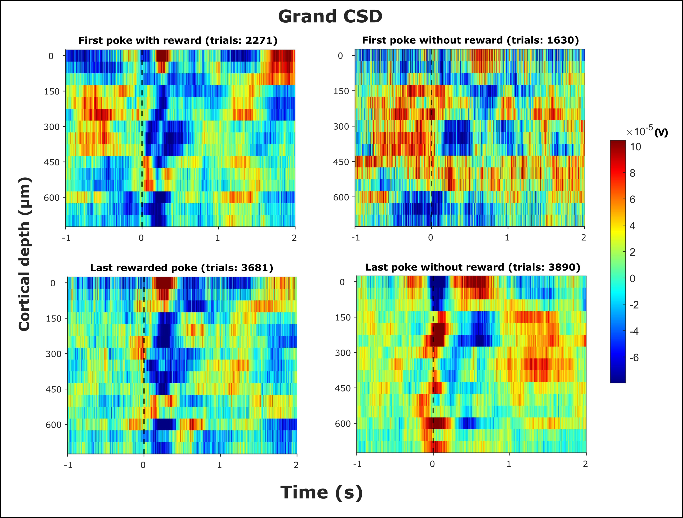
Grand CSD

Slide 9
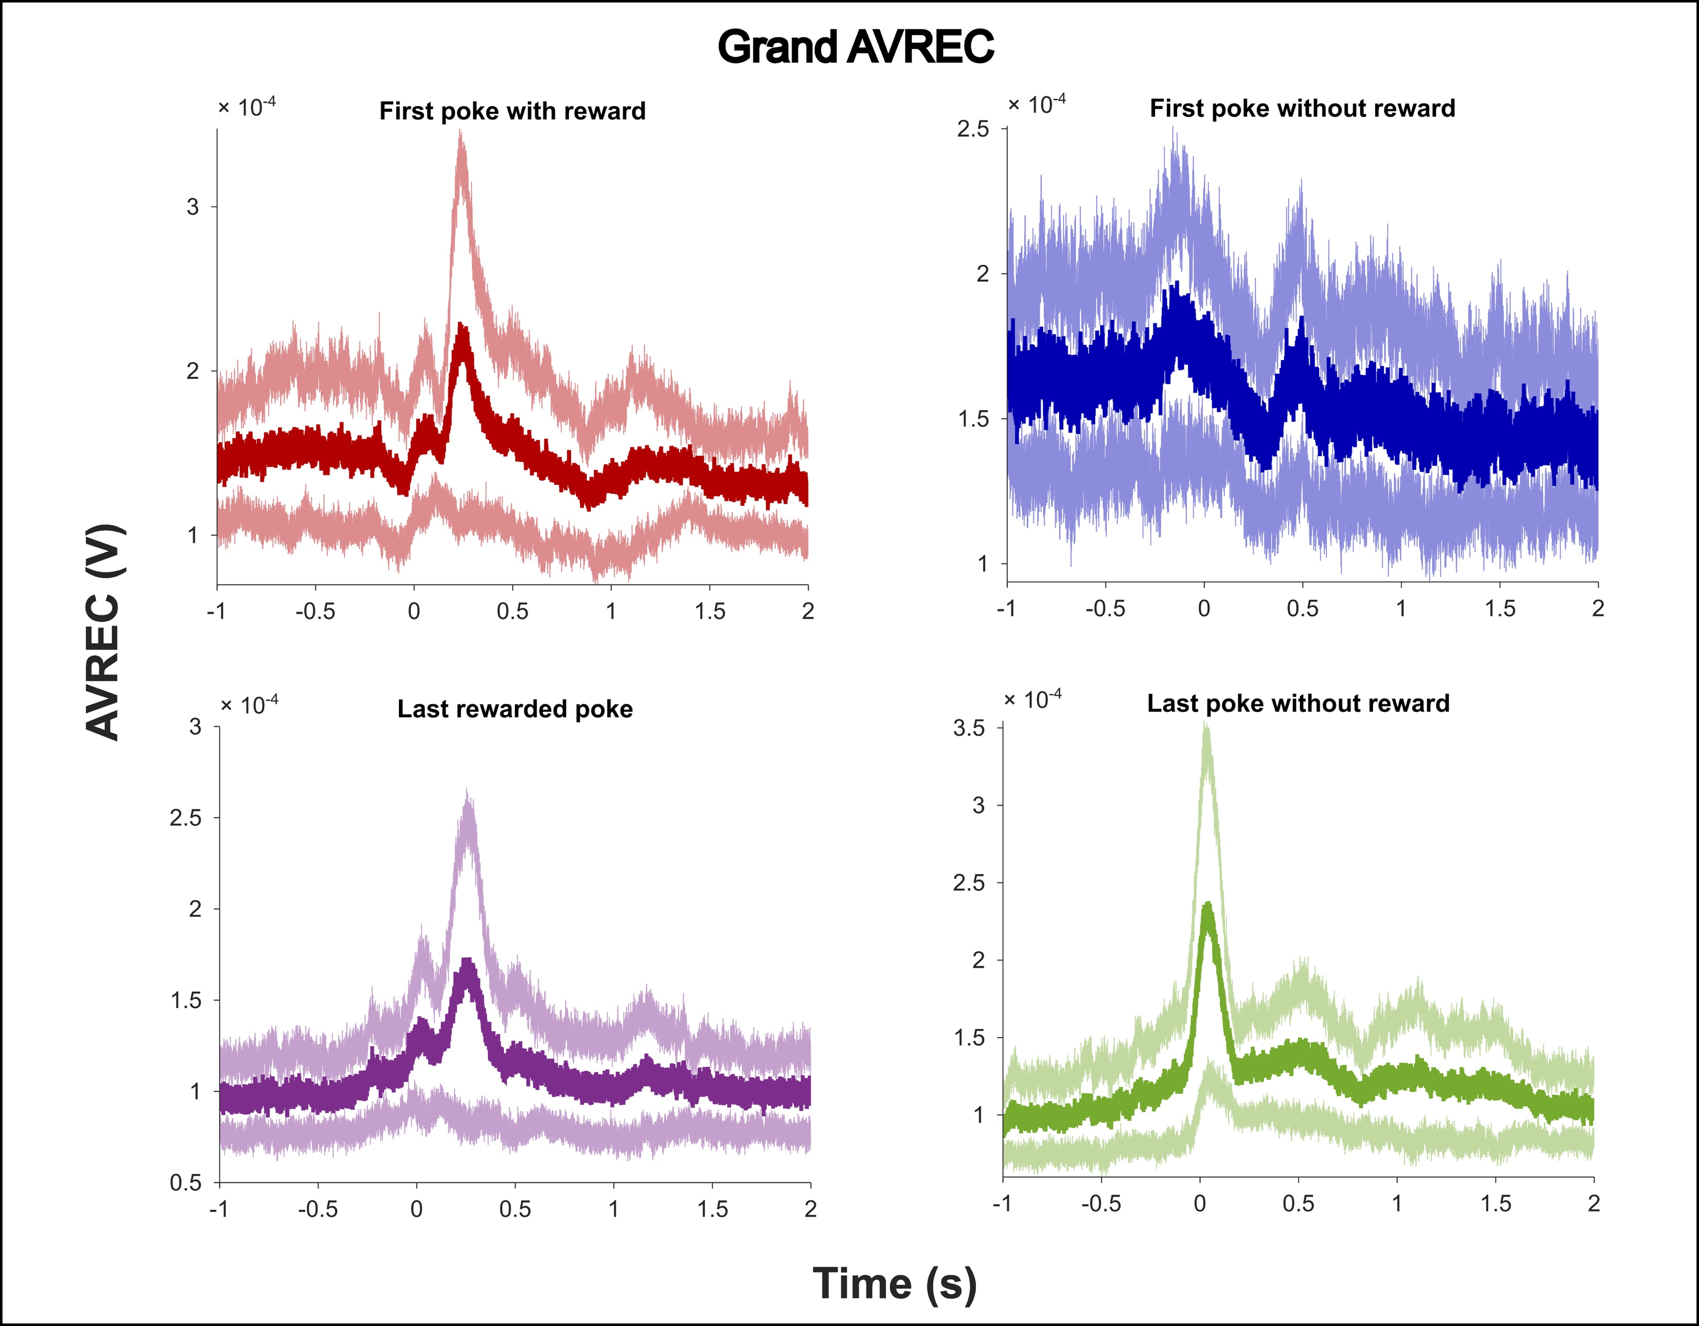
Grand AVREC

Slide 10
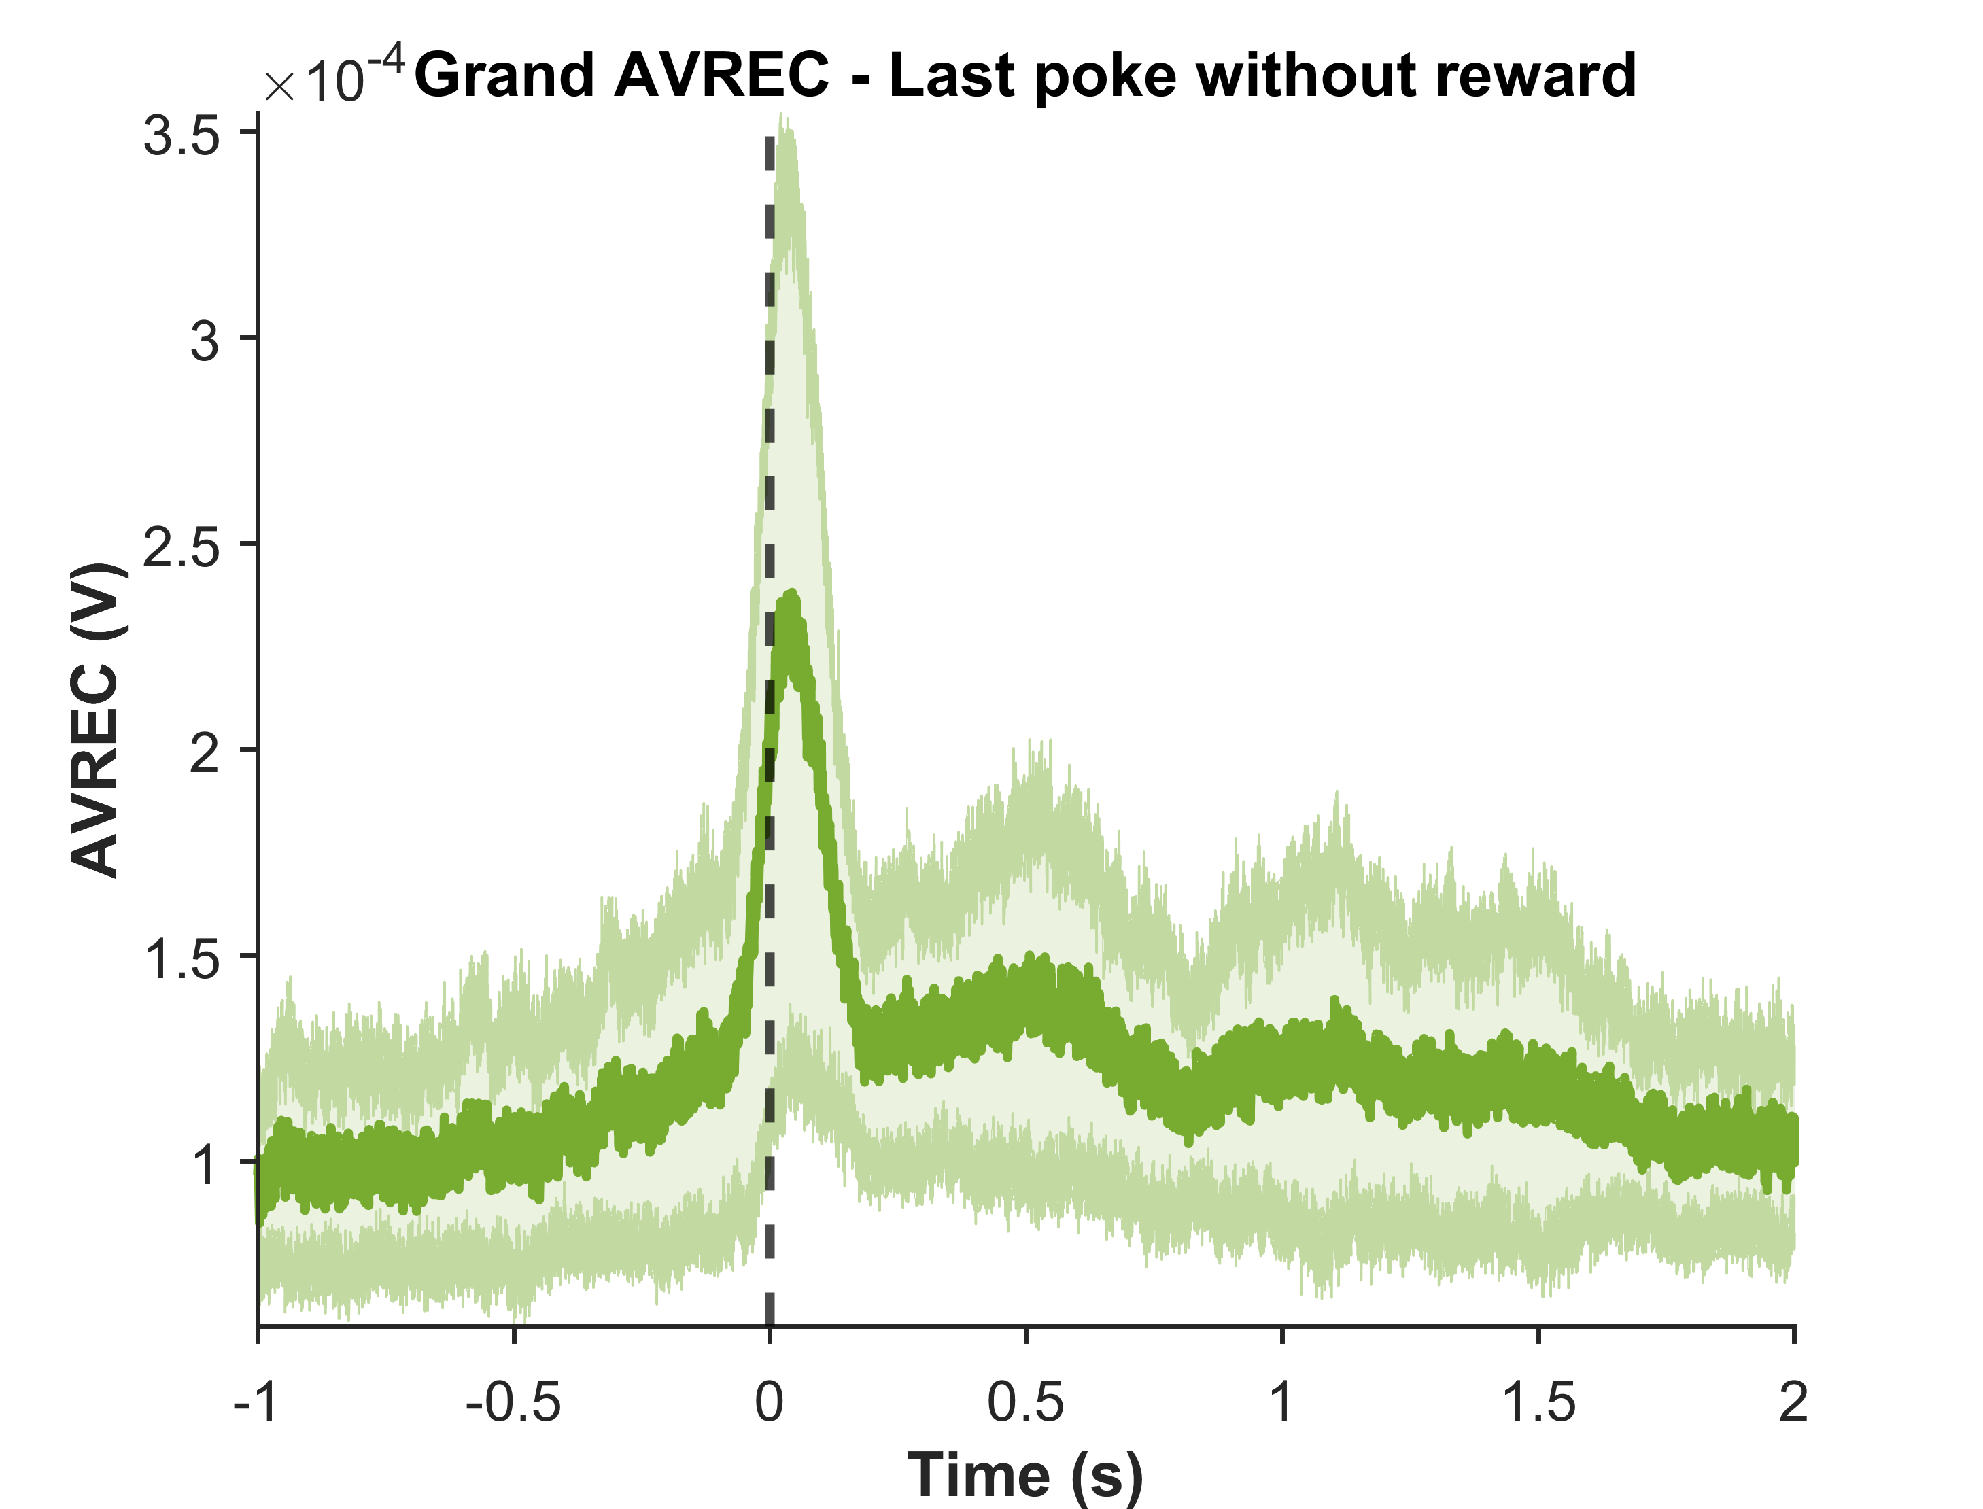
Grand AVREC
Before poke phase
Early phase
Late phase

Slide 11
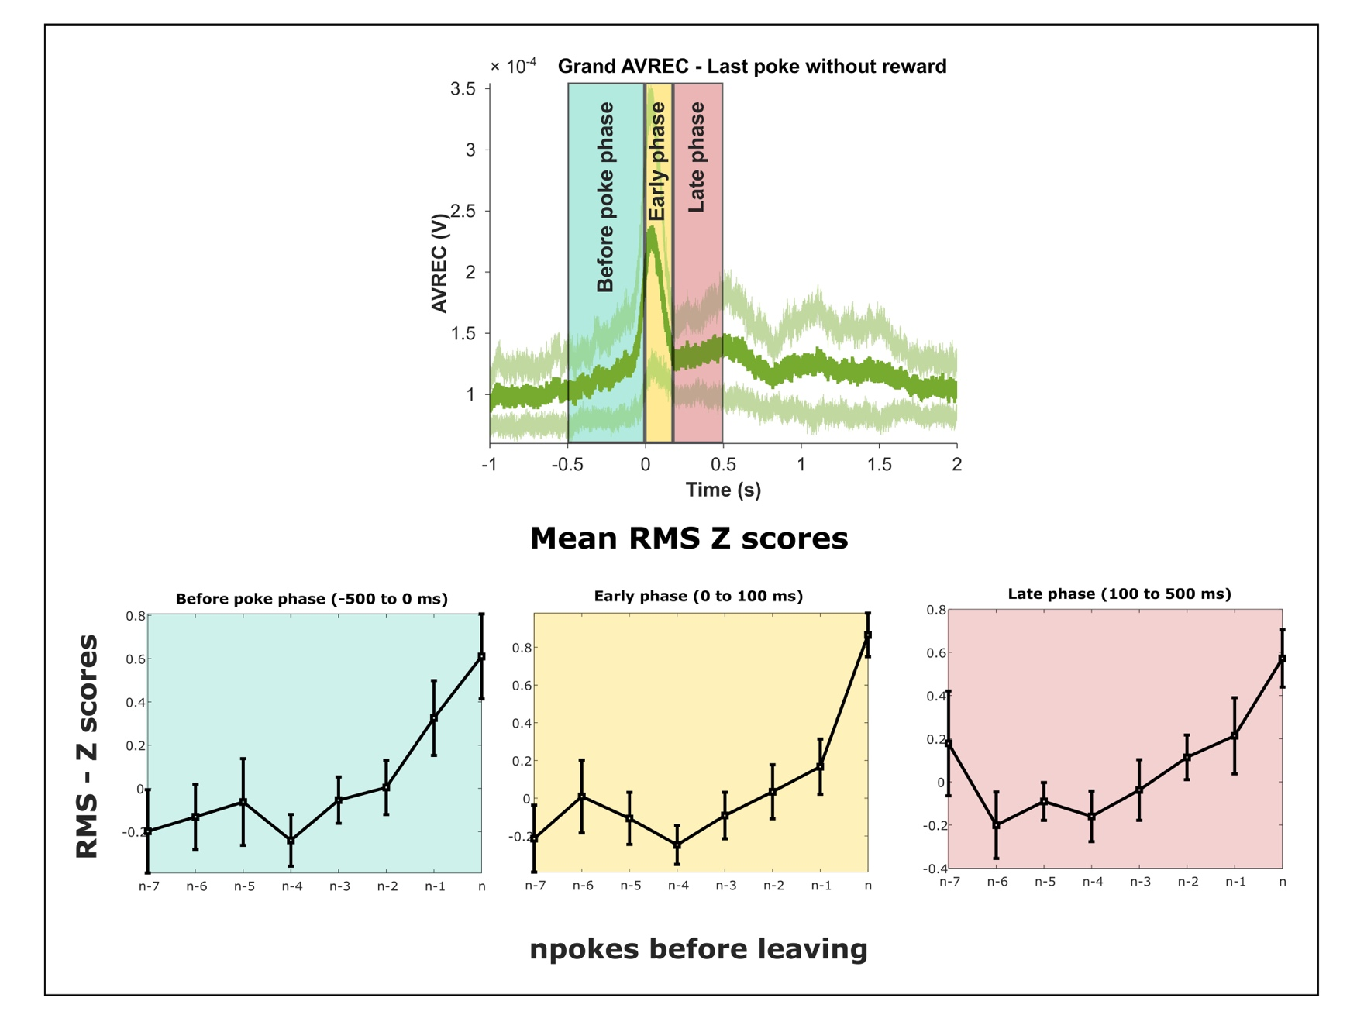
RMS analysis - Last rewarded poke to last poke

Slide 12
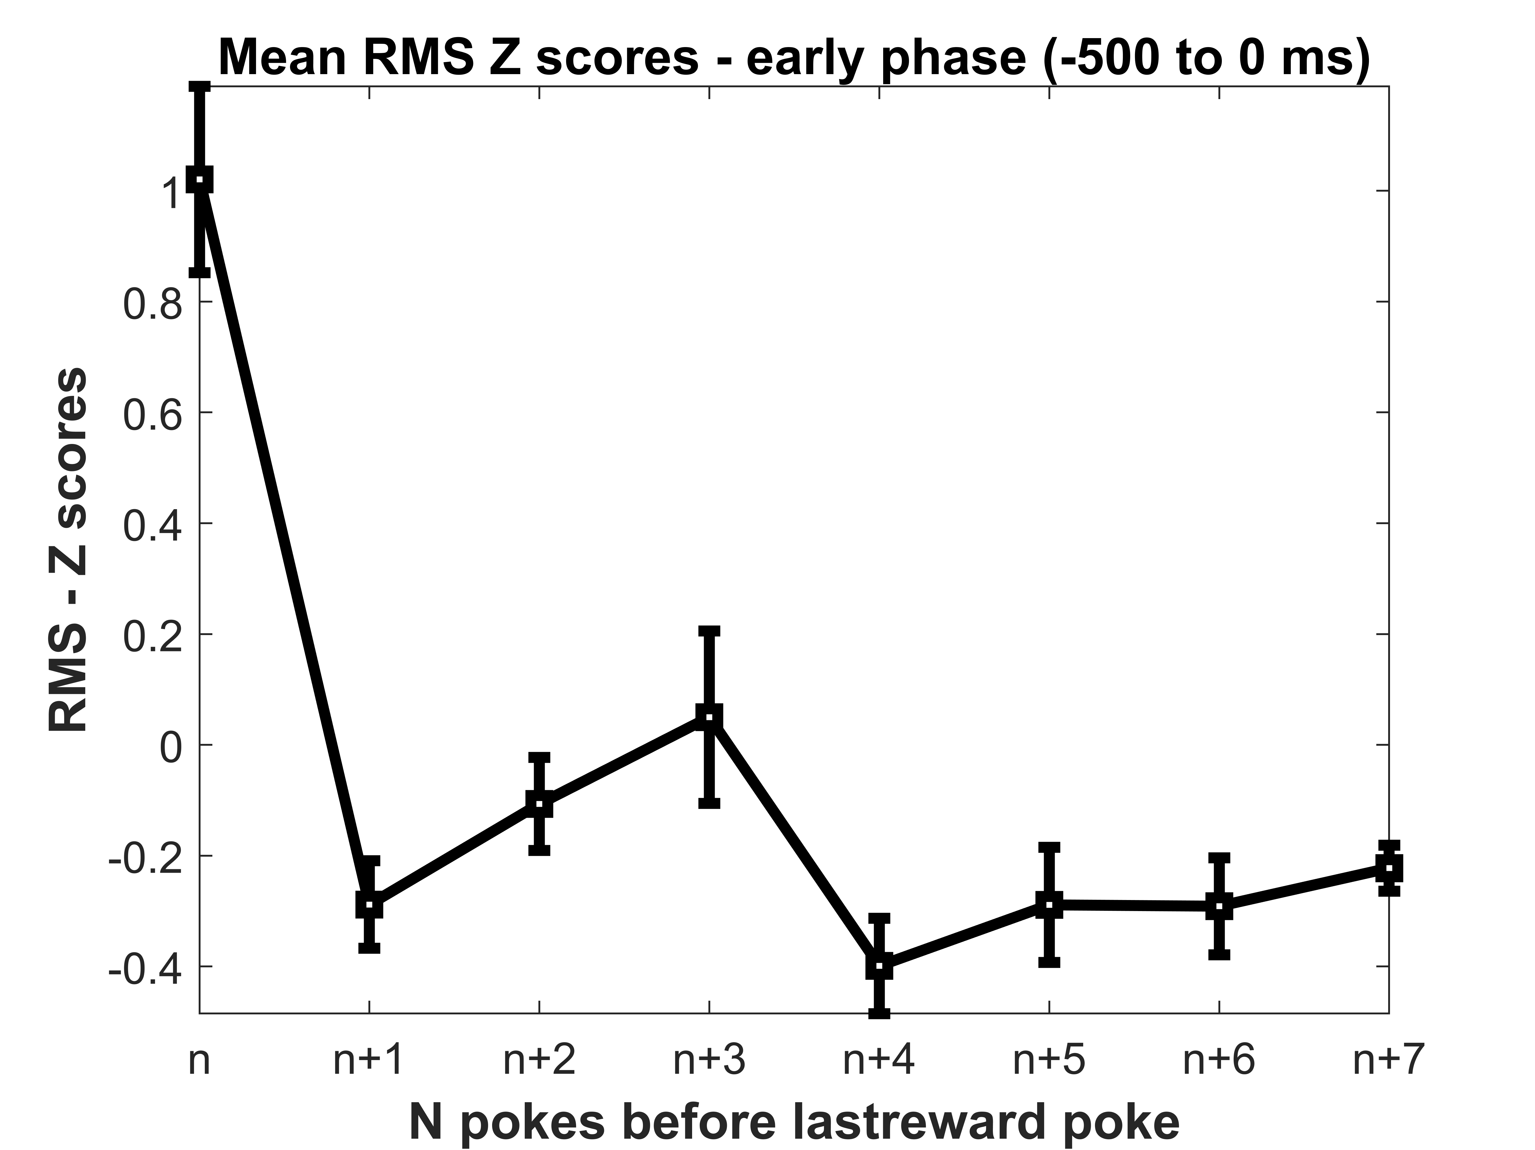
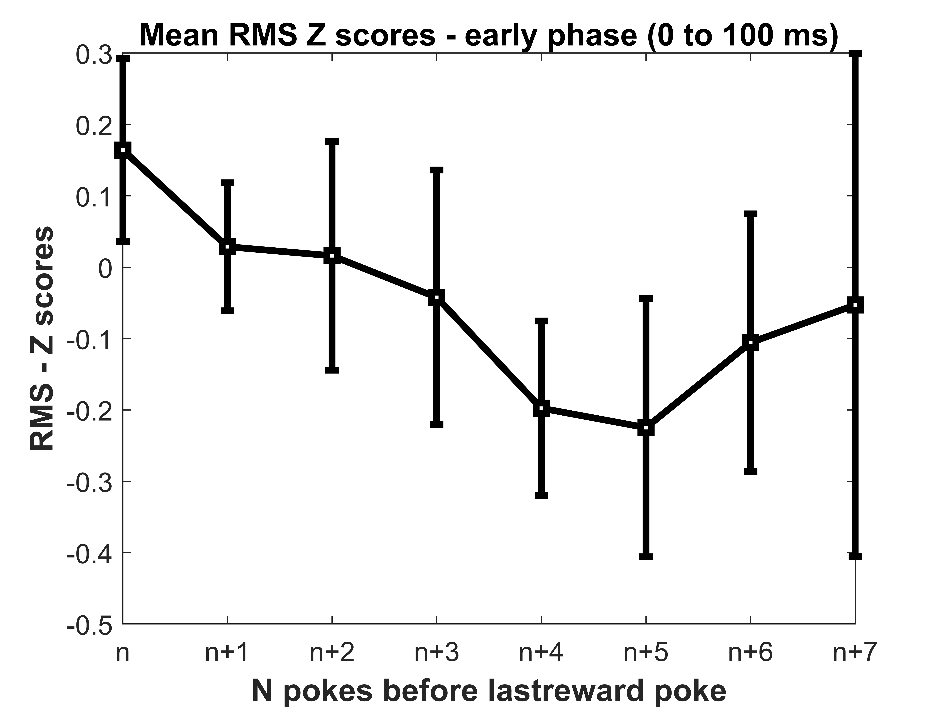
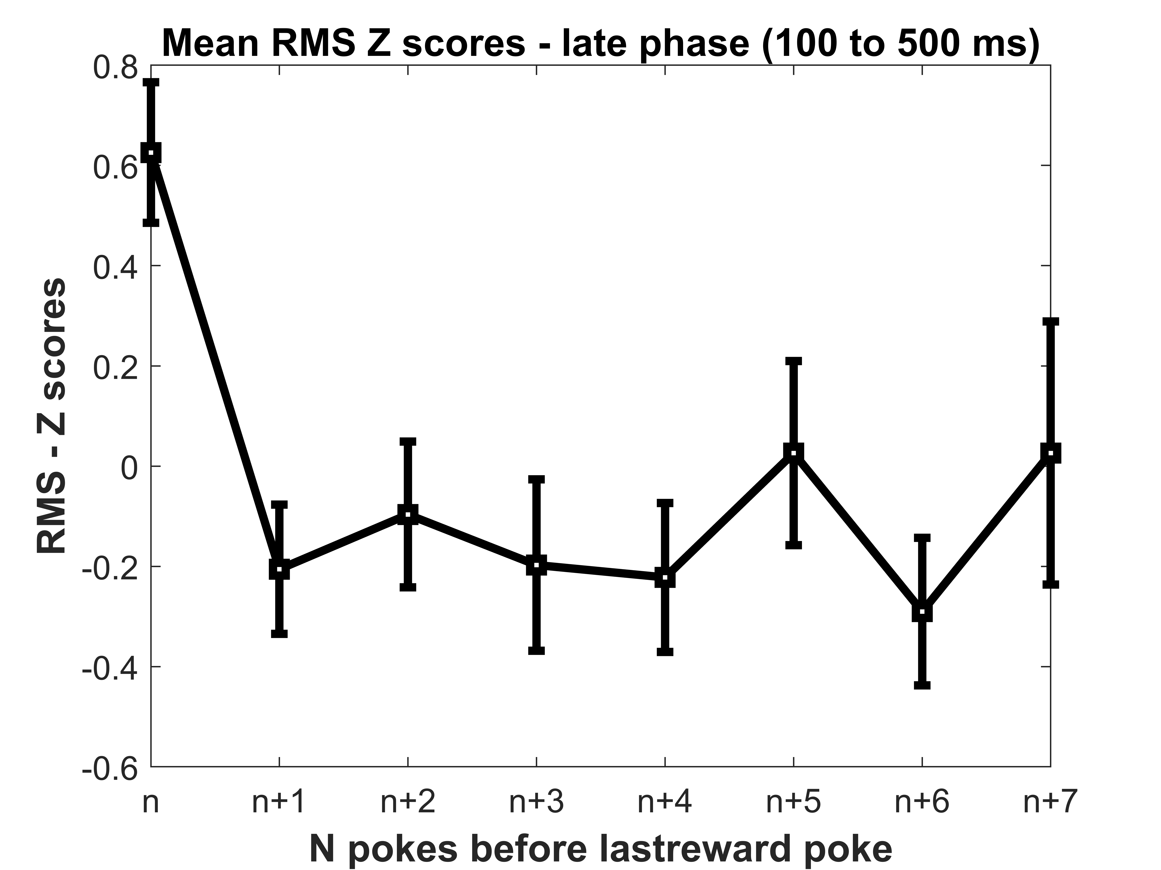
RMS analysis – First poke to last rewarded poke

Slide 13
Layer Analysis

Slide 14
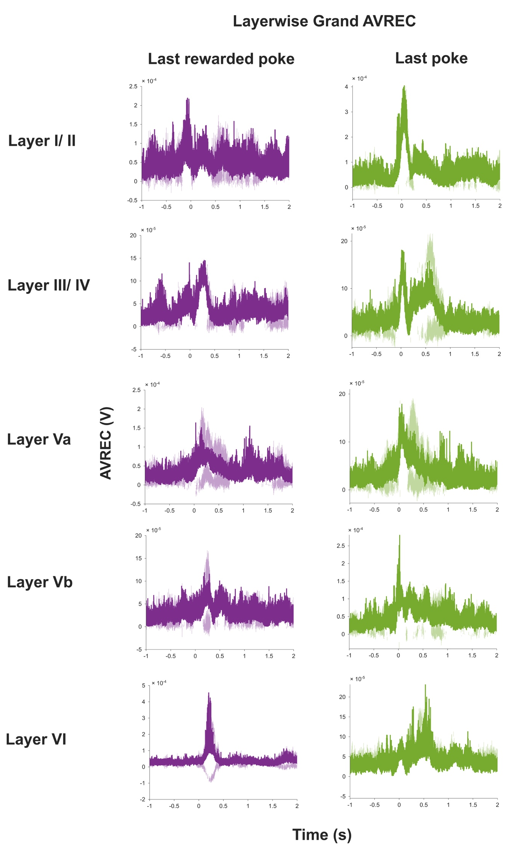
Grand layer wise average - Rectified sinks

Slide 15
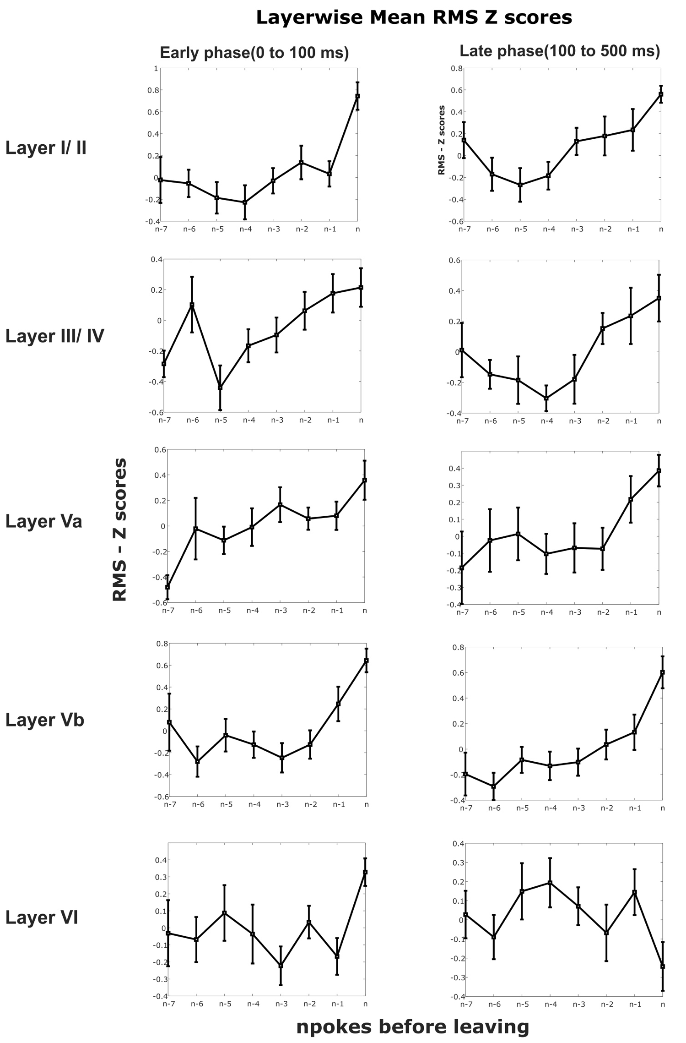
Grand layer wise RMS of rectified sinks last reward to last poke

Slide 16
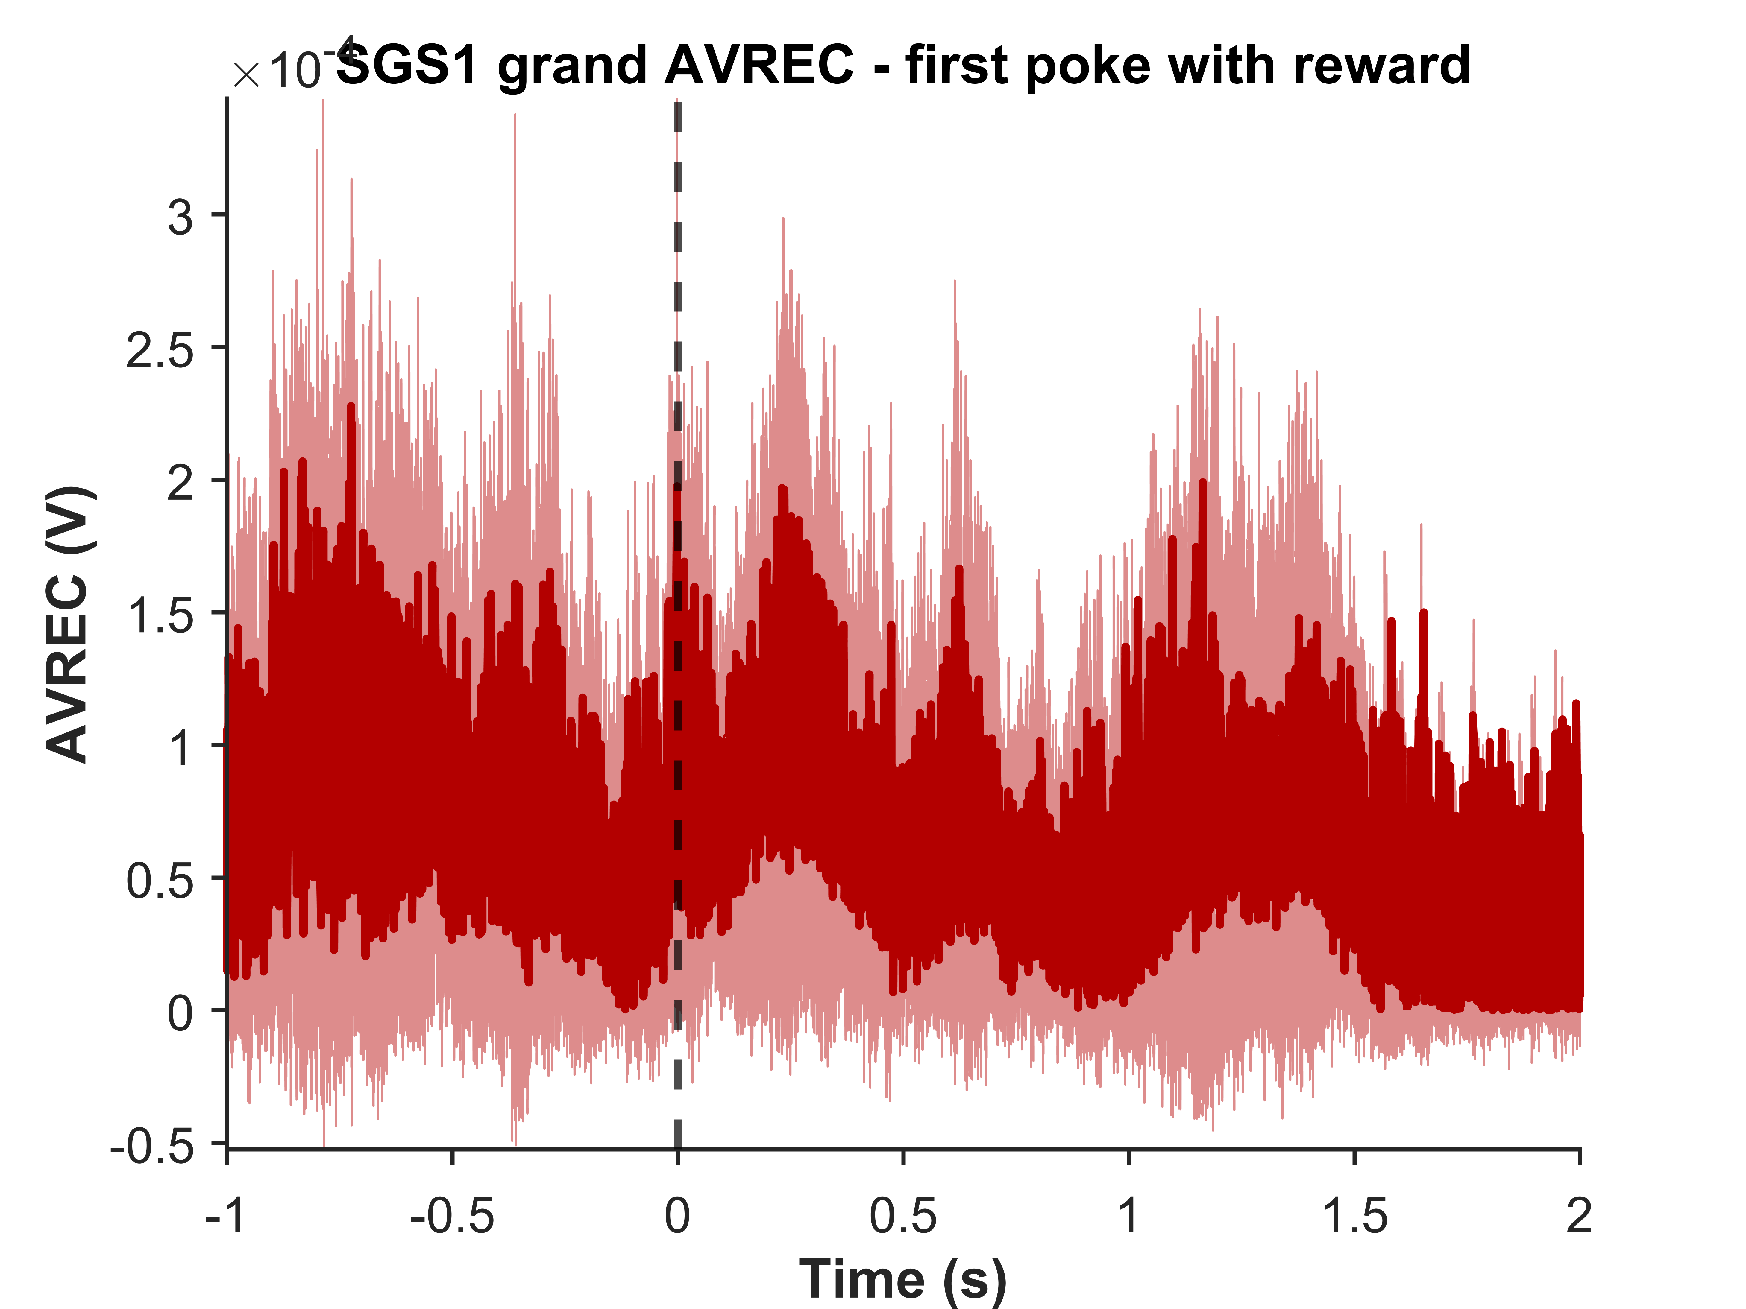
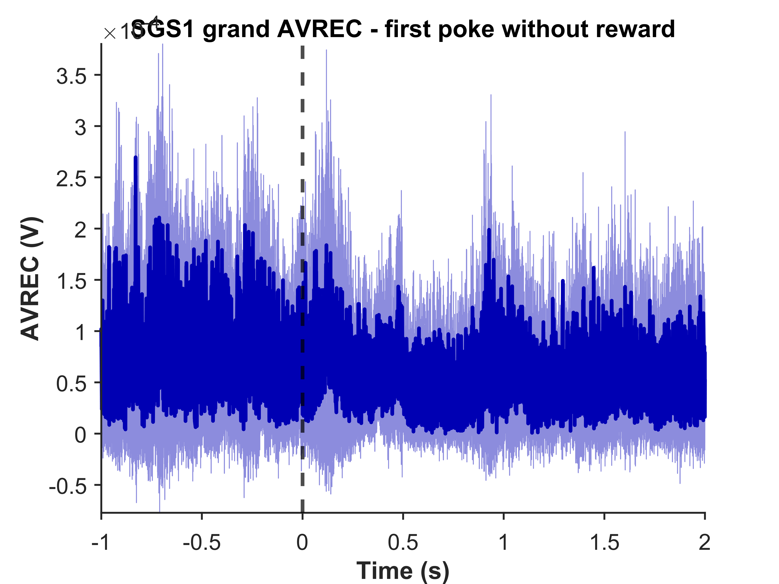
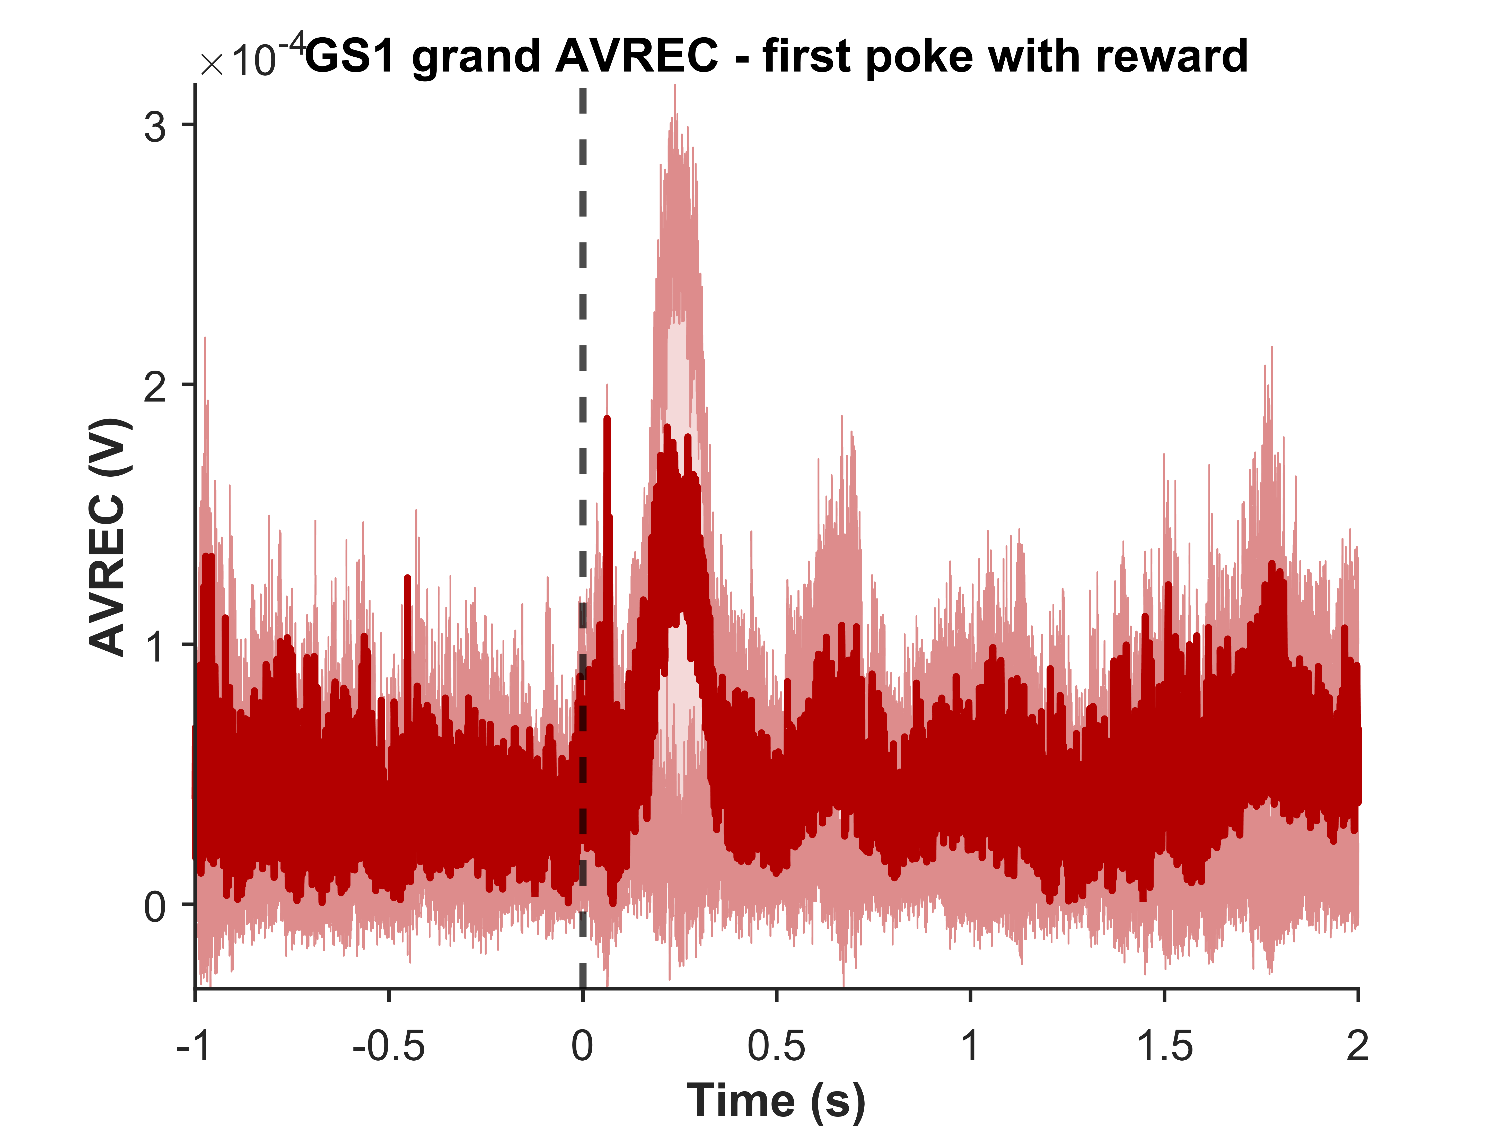
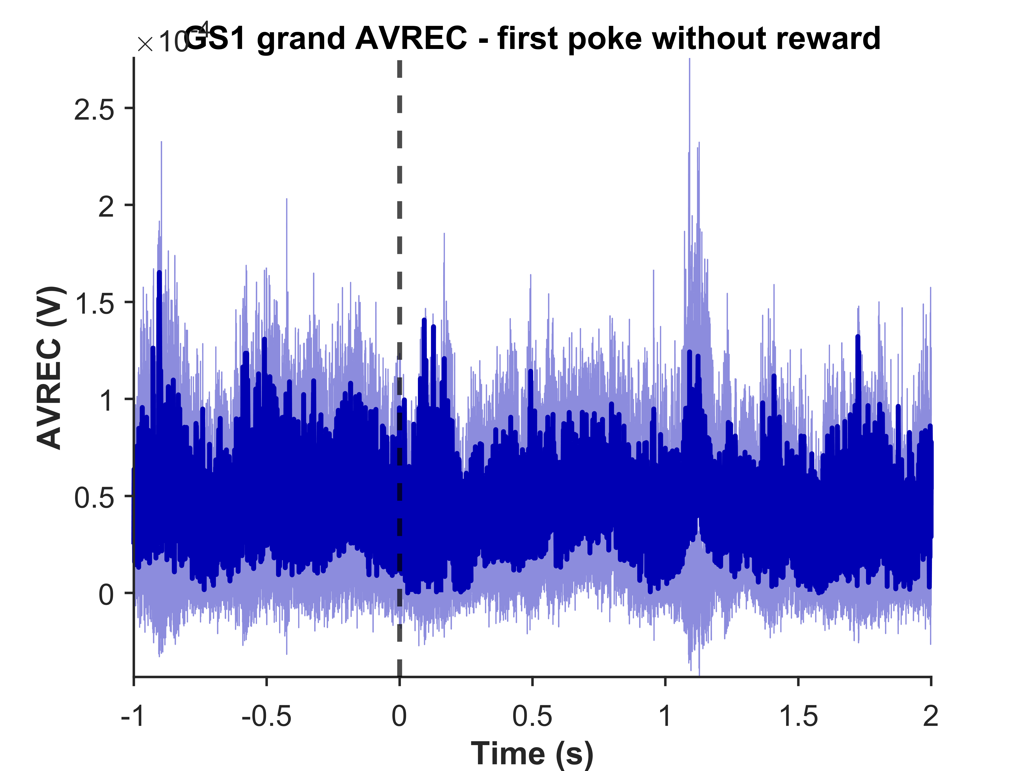
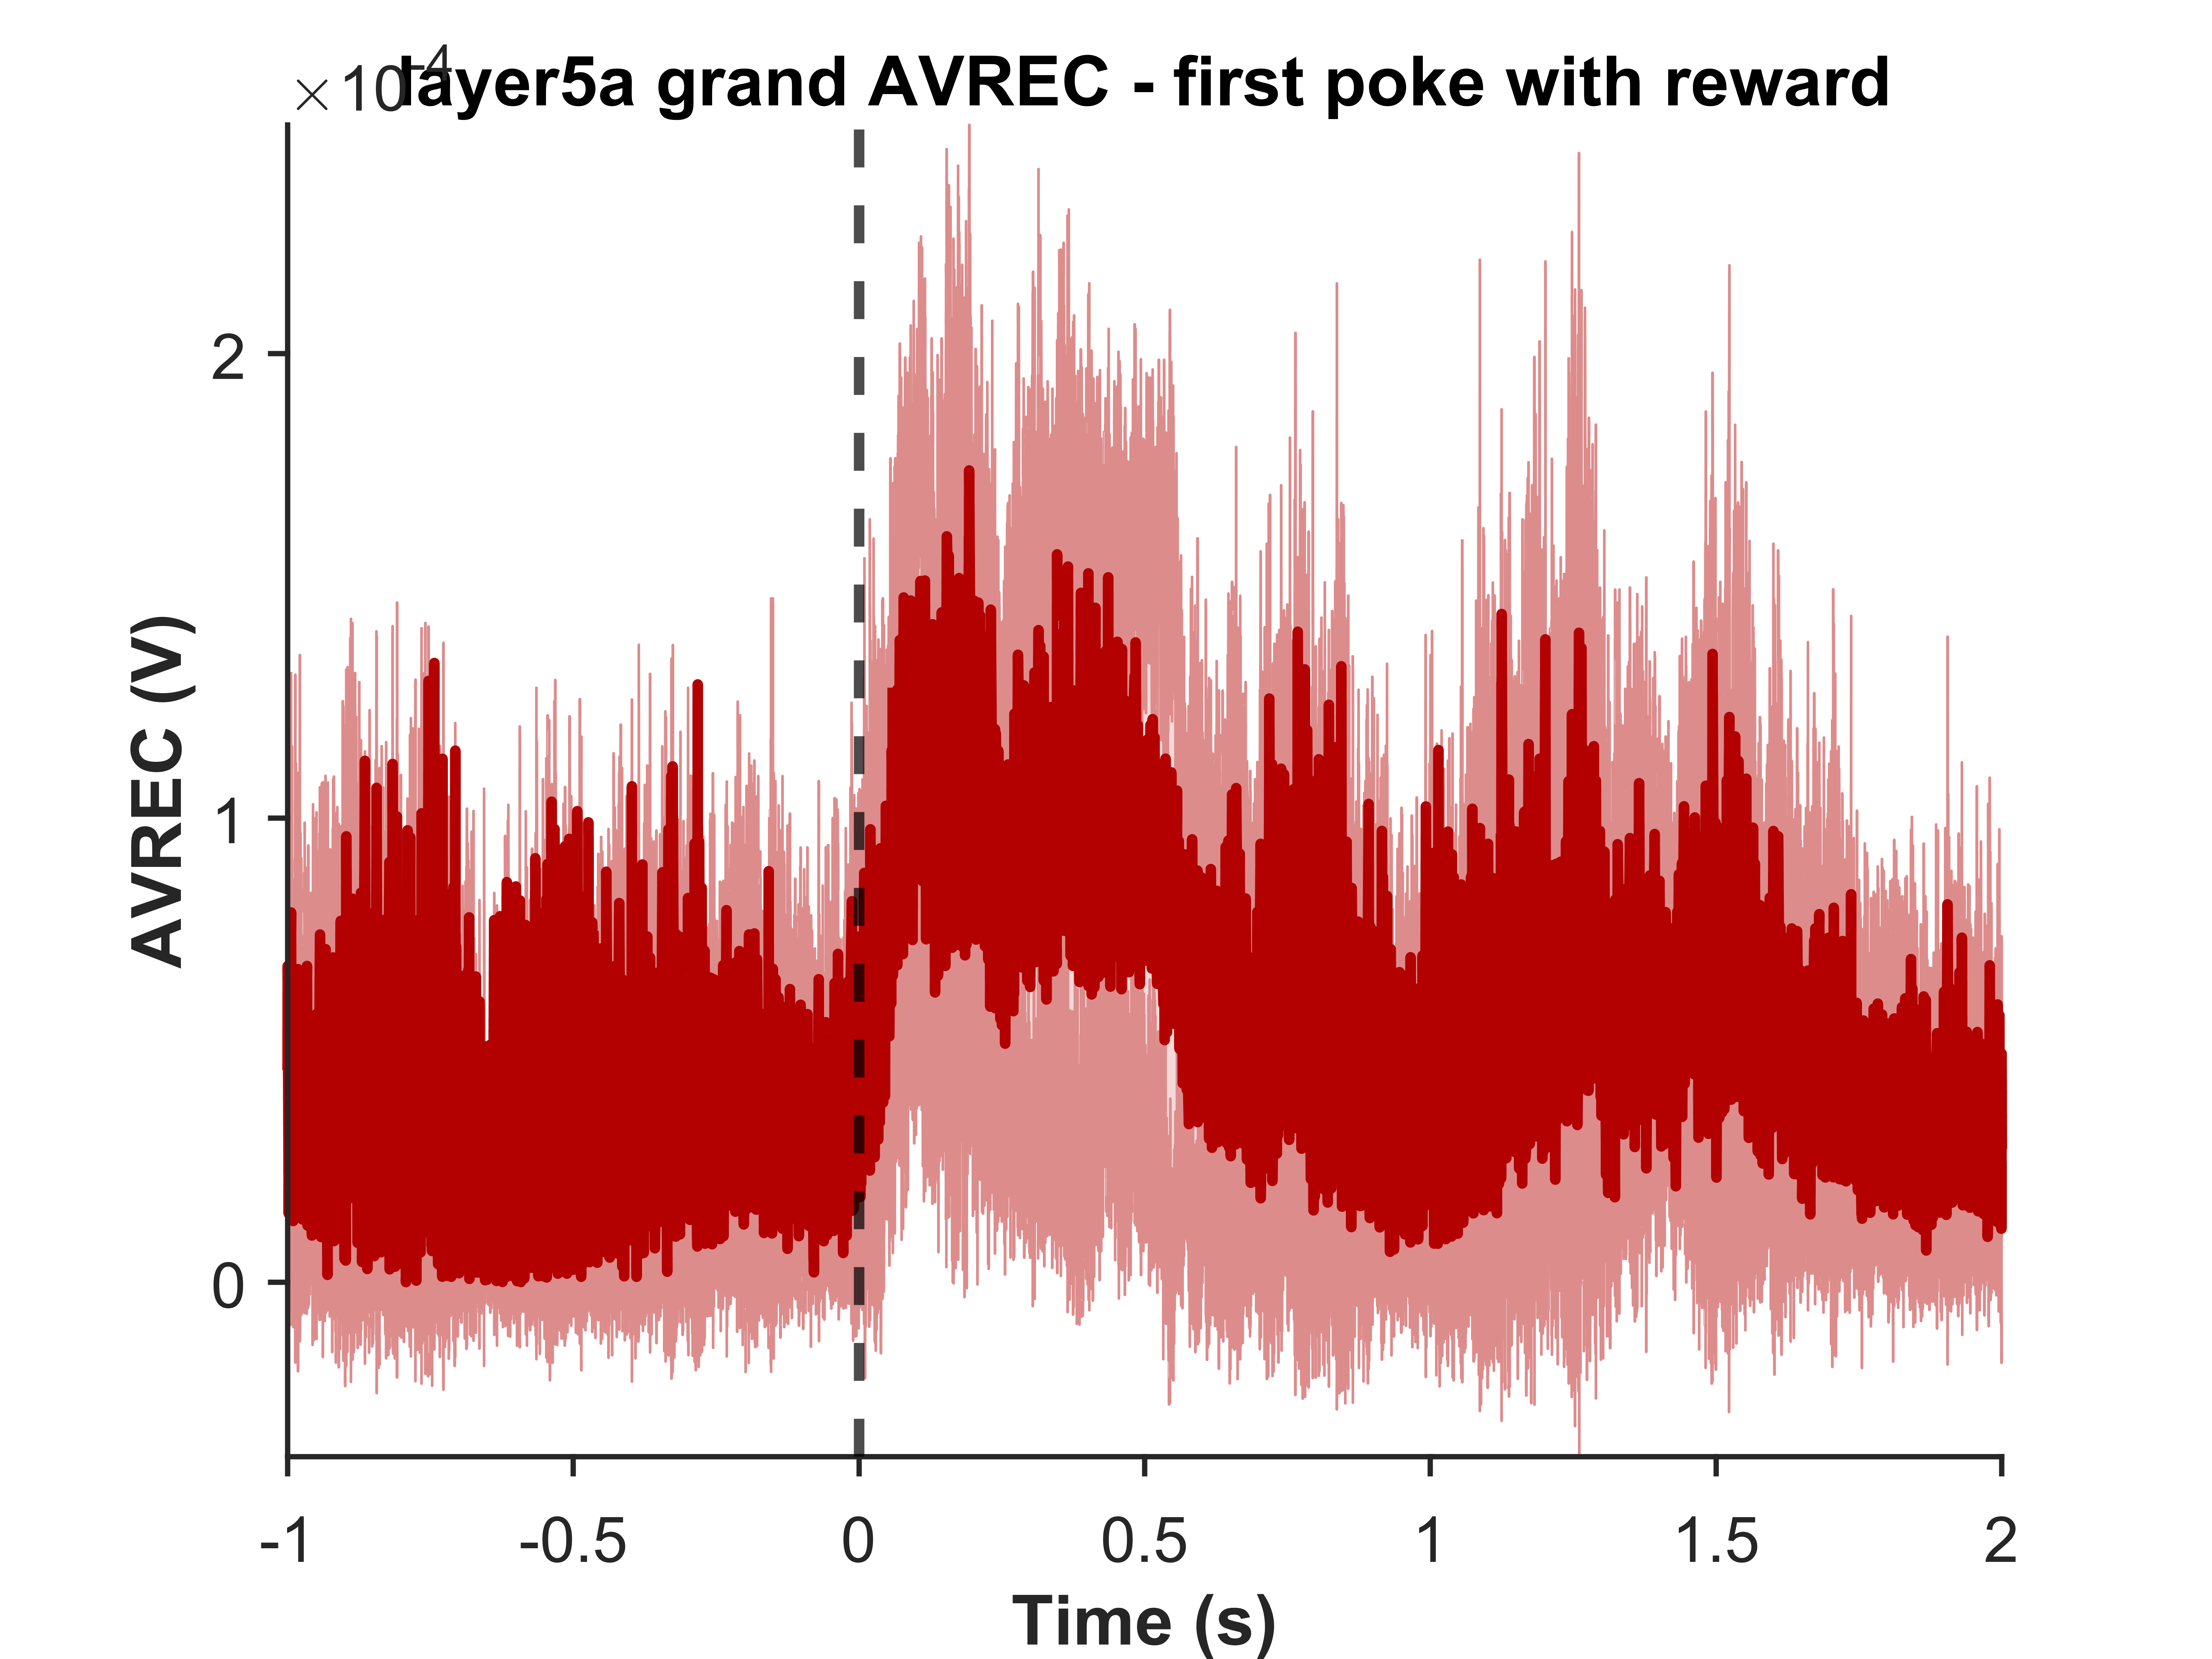
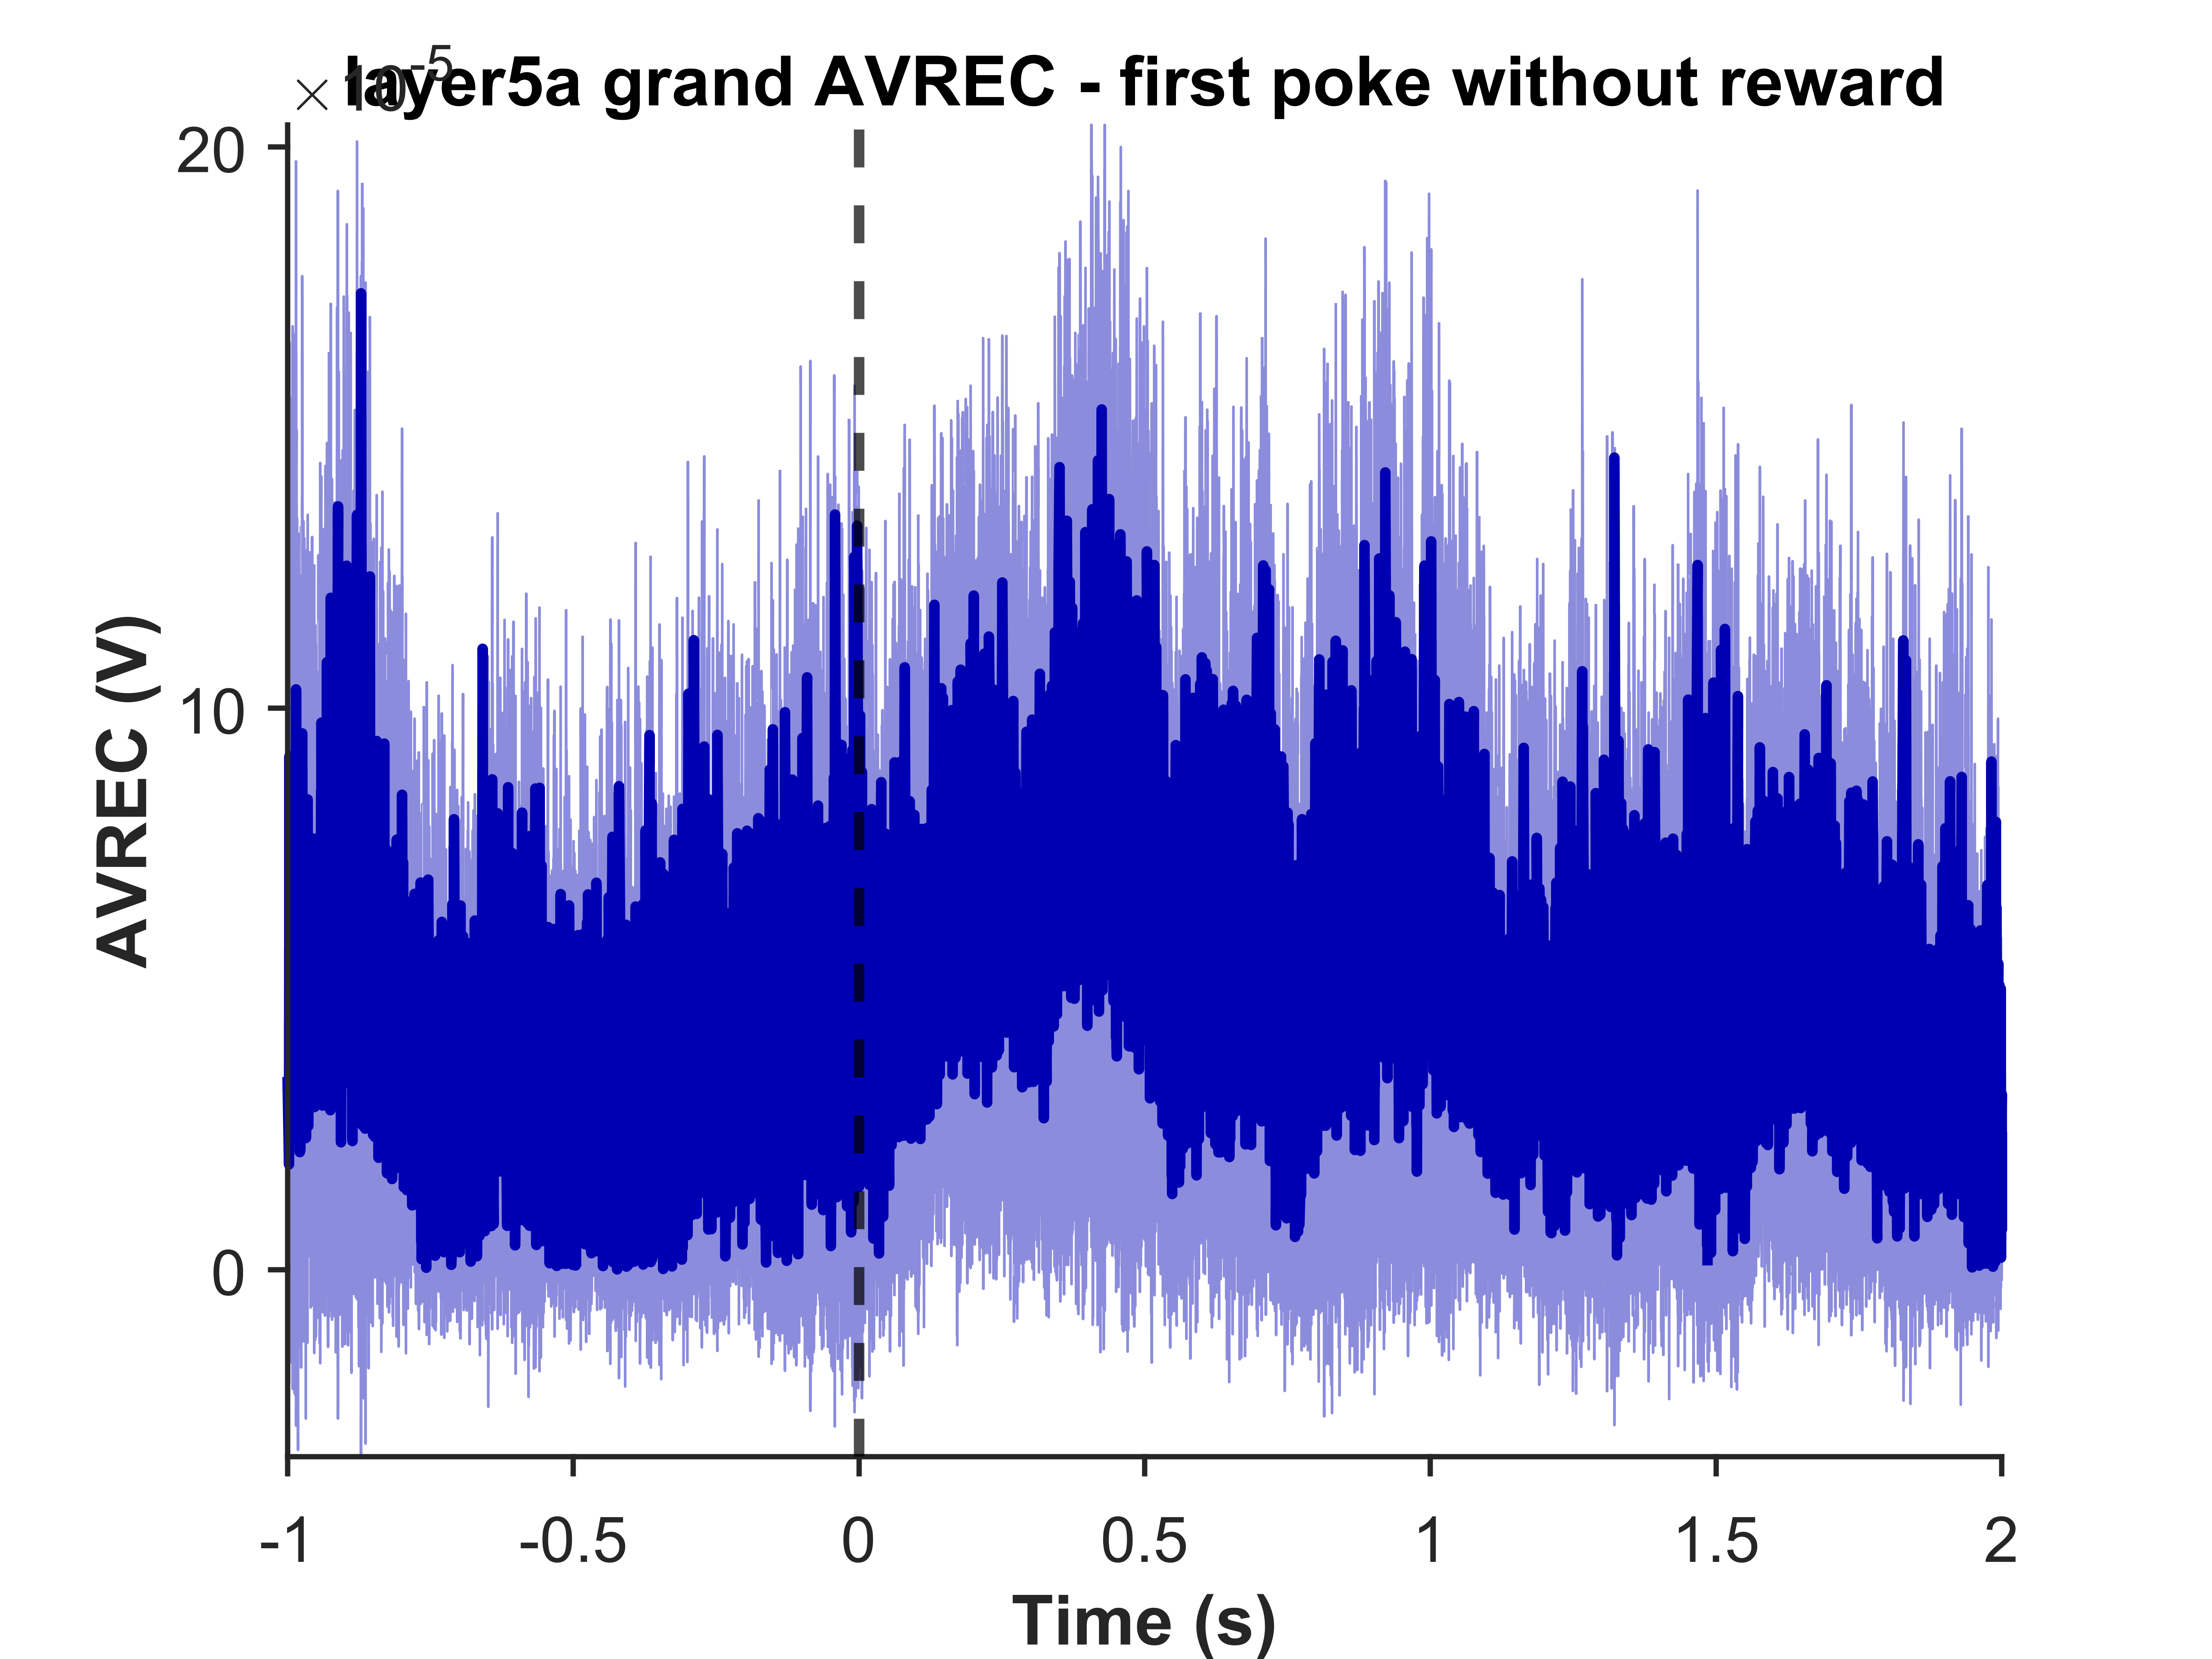
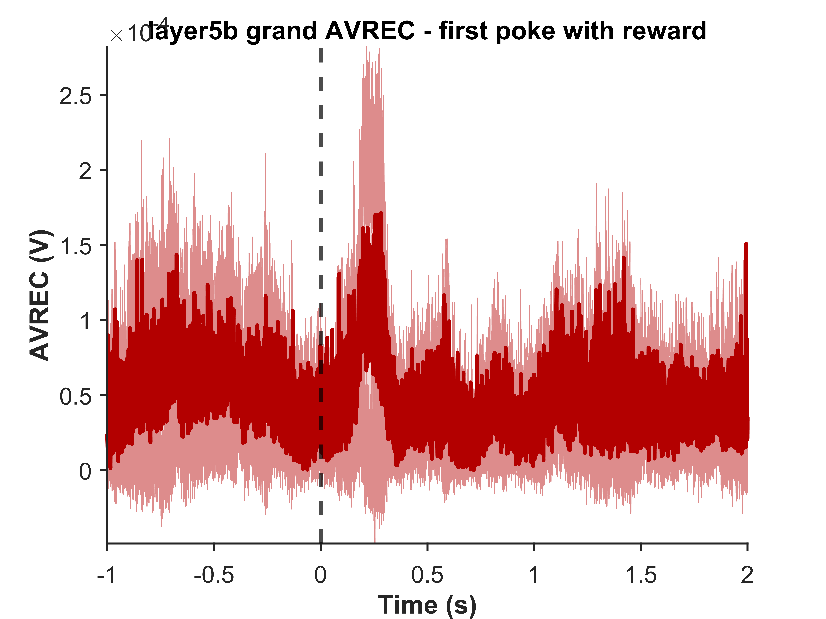
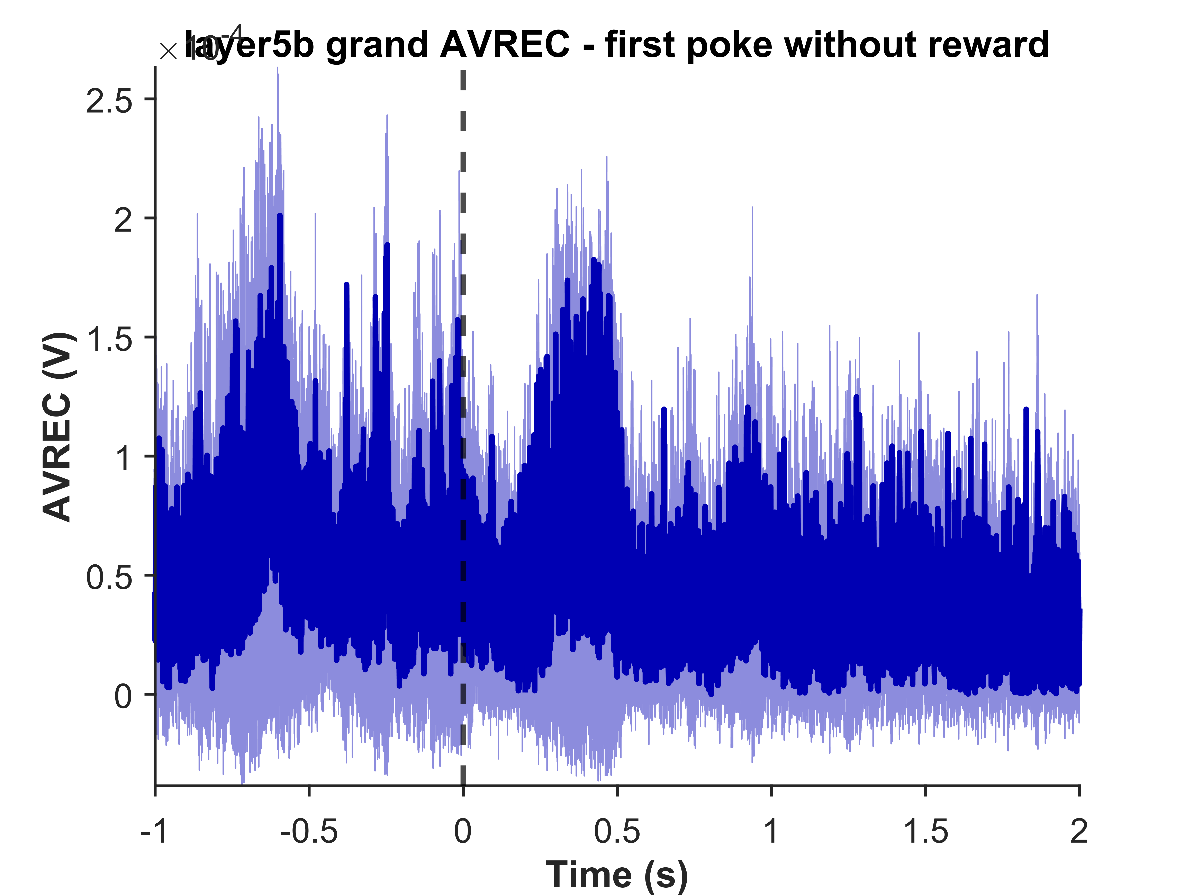
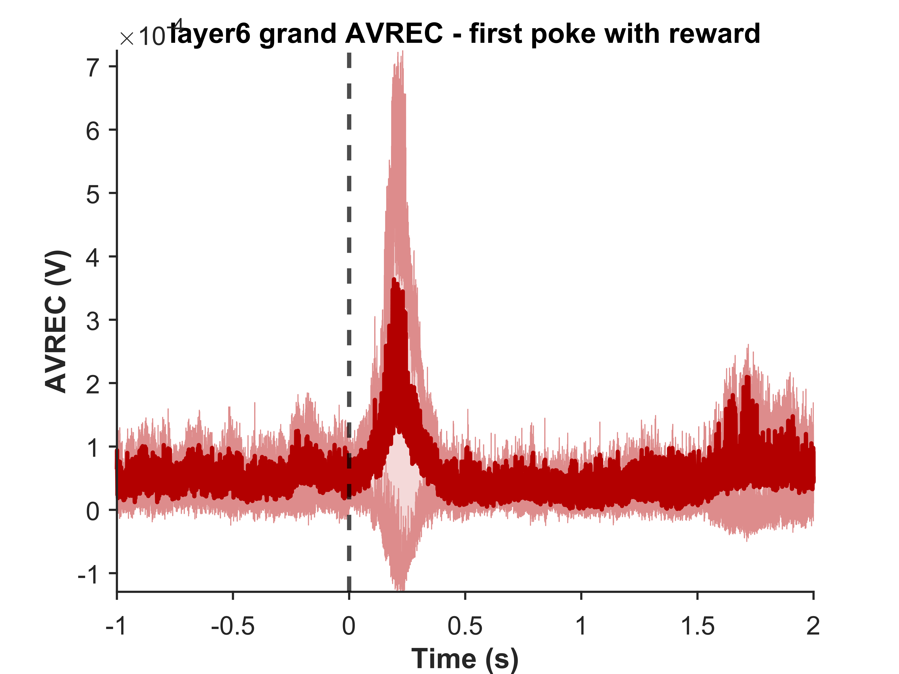
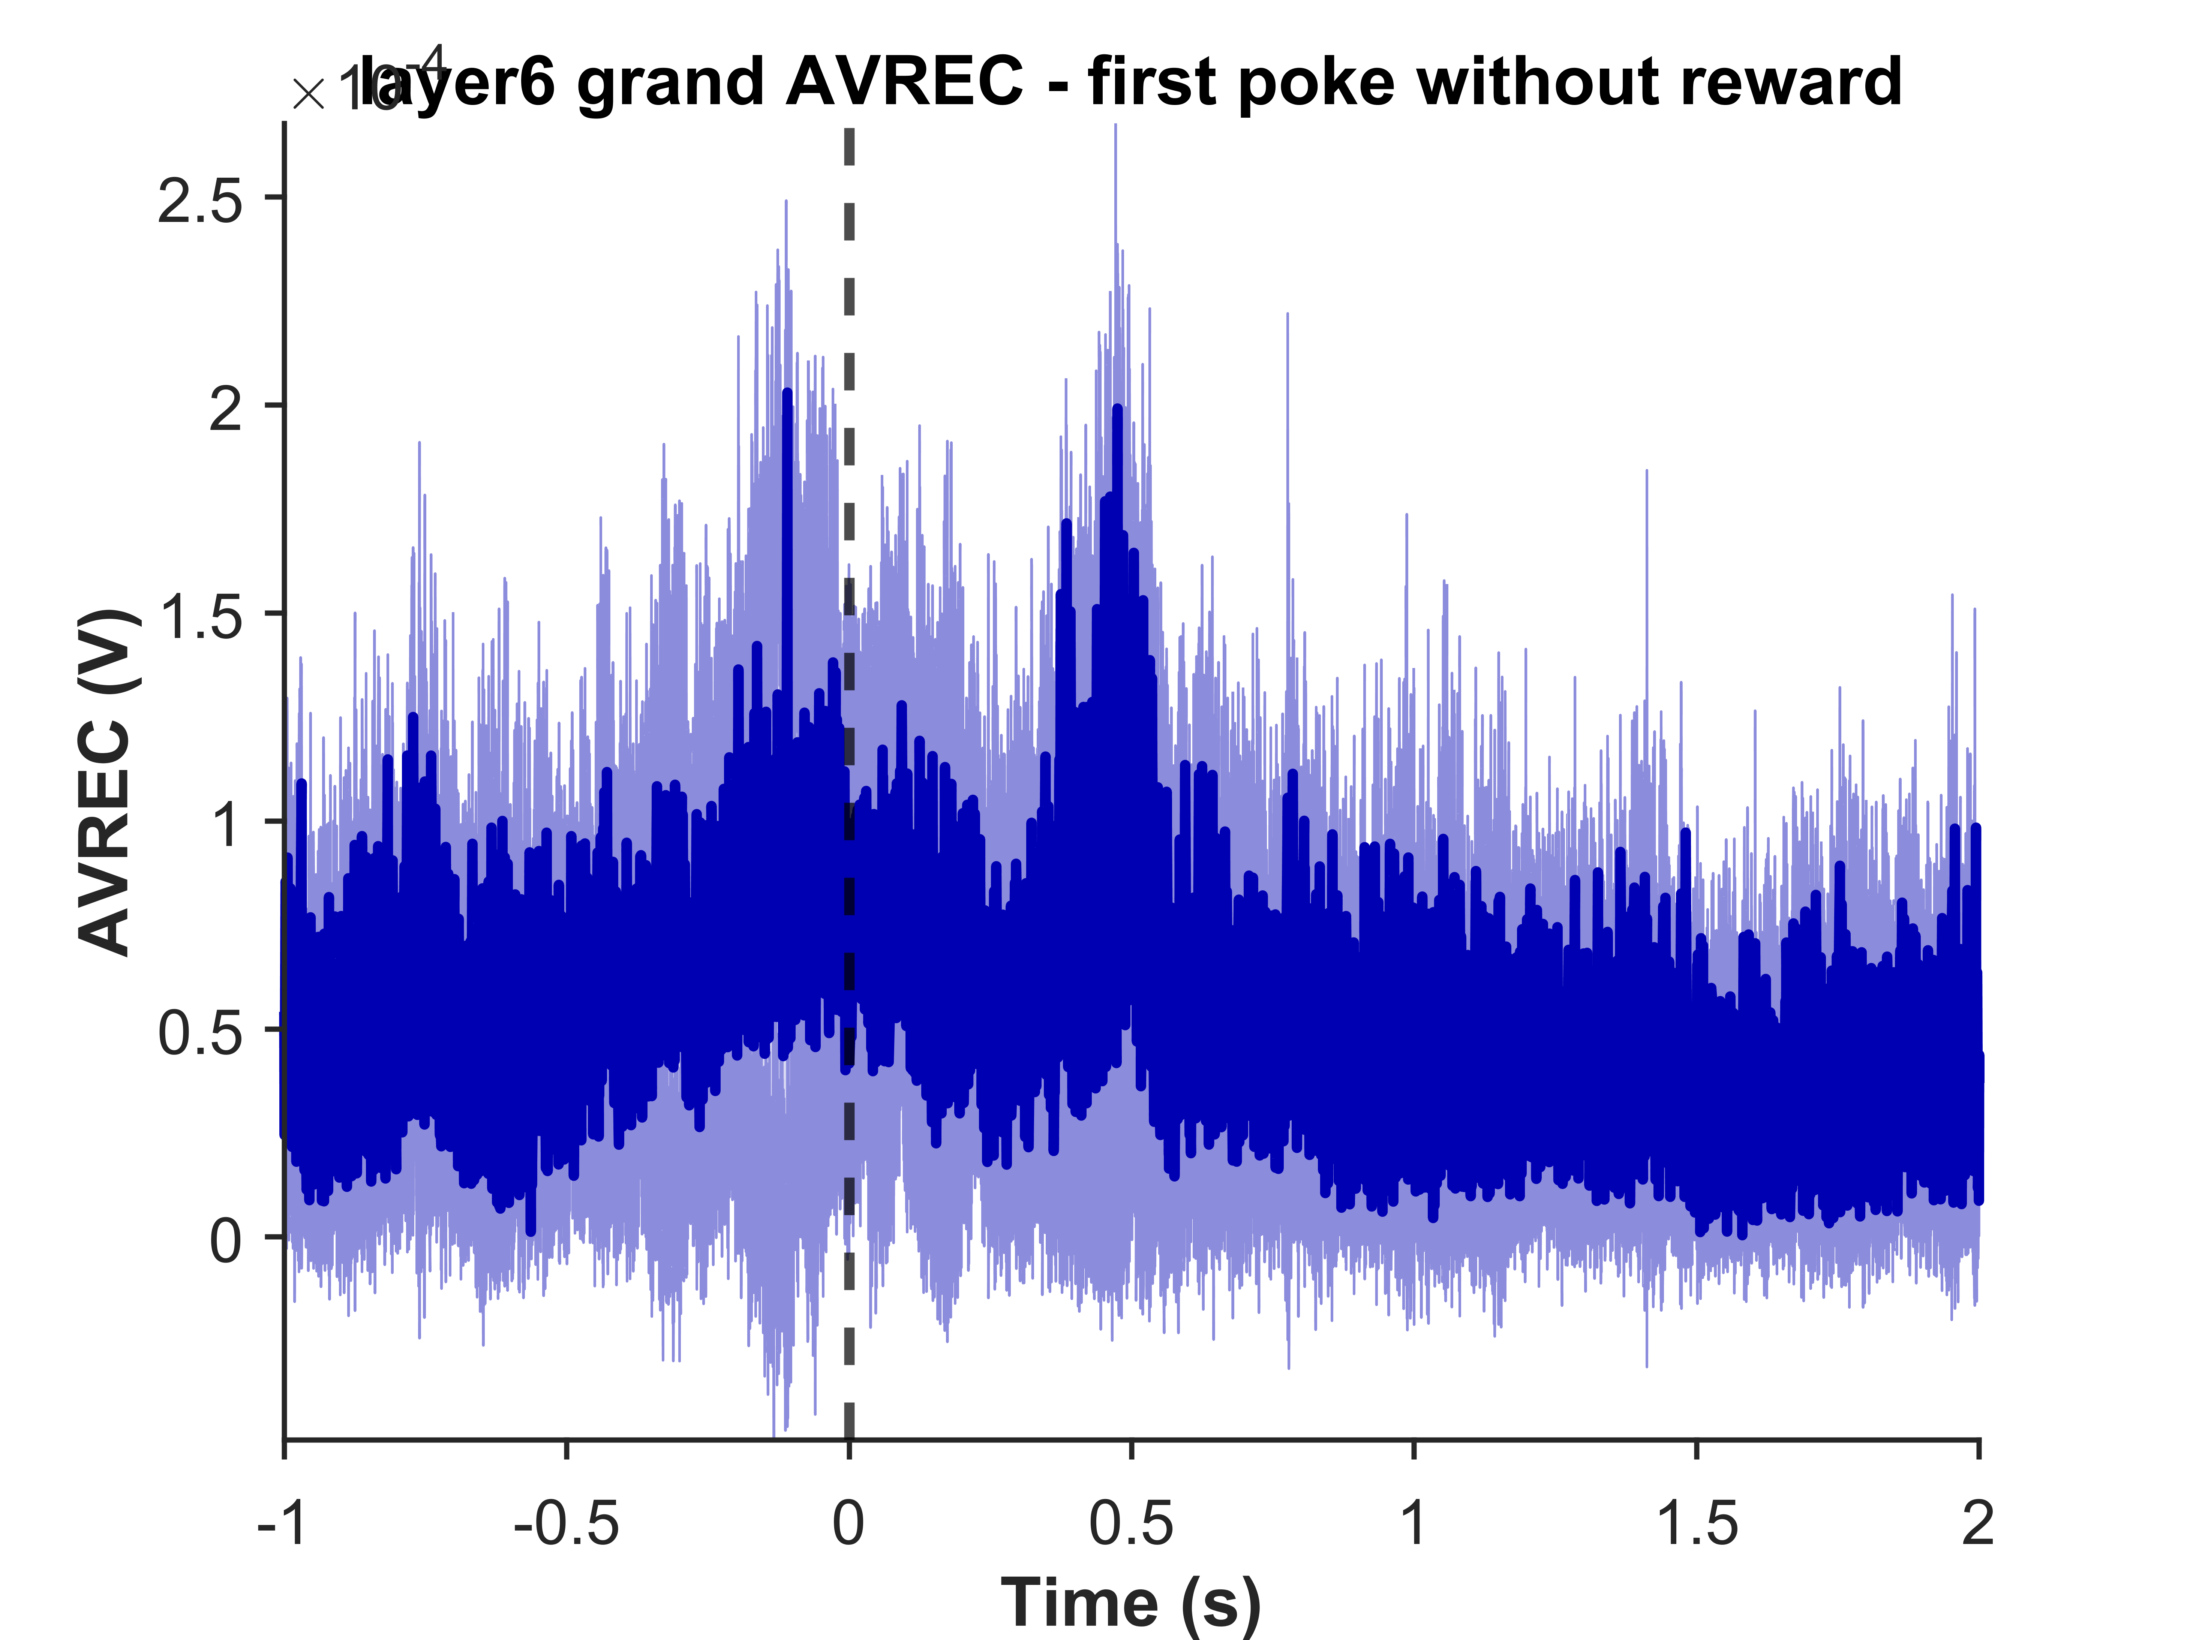
Grand layer wise average - Rectified sinks last reward to last poke
First poke with reward
First poke without reward
SGS1
GS1
Layer 5a
Layer 5b
Layer 6

